Slide 1

DengAI Competition
John Moderwell
MSDS 413 Final Project

Slide 2
Introduction
Dengue fever is a mosquito-borne disease that occurs in tropical and sub-tropical parts of the world. In mild cases, symptoms are similar to the flu: fever, rash, and muscle and joint pain. In severe cases, dengue fever can cause severe bleeding, low blood pressure, and even death.
Many scientists believe dengue fever may be related to climate change variables such as temperature and precipitation
In recent years, dengue fever has been spreading. Historically, the disease has been most prevalent in Southeast Asia and the Pacific islands. These days many of the nearly half-billion cases per year are occurring in Latin America.

Slide 3
Data Description
The data consists of a train and test set for two cities: San Juan, Puerto Rico and Iquitos, Peru. There is a data set with labels for the total number of cases also provided for the training set. The goal is to predict the total_cases label for each city. The test data covers 5 years for San Juan and 3 years for Iquitos. Both the training (1456 observations) and test set (416 observations) have 24 variables.

Slide 4
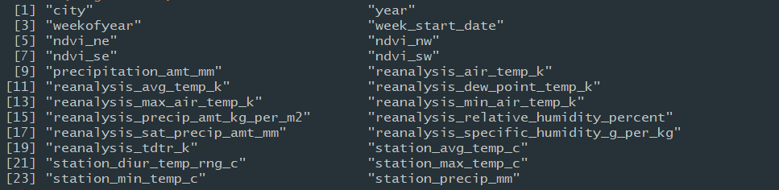
Variables Under Consideration

Slide 5
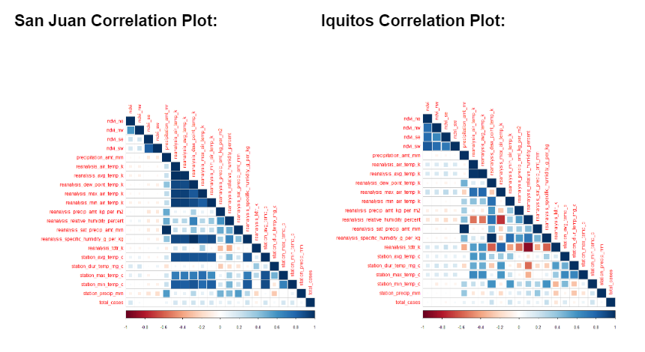
Correlation Plots

Slide 6
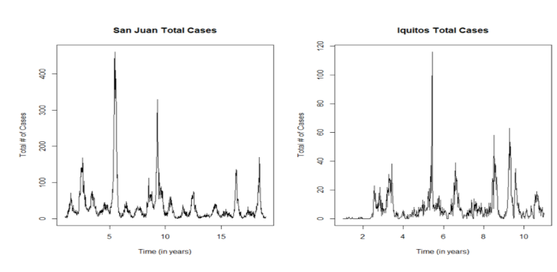
San Juan Total Cases vs. Iquitos Total Cases

Slide 7
Models
From these plots, there appears to be some seasonality and the data seems to be stationary. From here, I built three types of models:
Linear regression models (using automatic backward variable selection)
ARIMA (using auto.arima and external regressors)
NNET (Neural Net) models (nnetar function in R)

Slide 8
Peer Reviewed Examples
Mishra, Bhogendra, et al. “An Artificial Neural Network-Based Snow Cover Predictive Modeling in the Higher Himalayas.” Journal of Mountain Science, vol. 11, no. 4, 2014, pp. 825–837.
Jian, et al. “An Application of ARIMA Model to Predict Submicron Particle Concentrations from Meteorological Factors at a Busy Roadside in Hangzhou, China.” Science of the Total Environment, vol. 426, 2012, pp. 336–345.
Khatibi, et al. “Developing a Predictive Tropospheric Ozone Model for Tabriz.” Atmospheric Environment, vol. 68, 2013, pp. 286–294.
Aertsen, et al. “Comparison and Ranking of Different Modelling Techniques for Prediction of Site Index in Mediterranean Mountain Forests.” Ecological Modelling, vol. 221, no. 8, 2010, pp. 1119–1130.
Jin, et al. “Non-Linear and Mixed Regression Models in Predicting Sustainable Concrete Strength.” Construction and Building Materials, vol. 170, 2018, pp. 142–152.

Slide 9
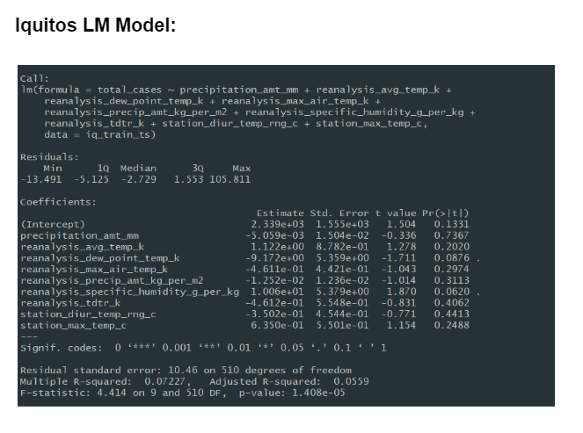
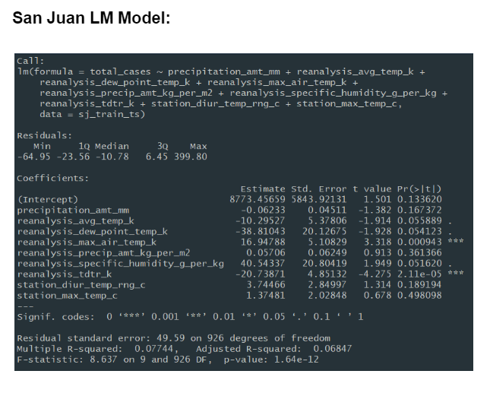
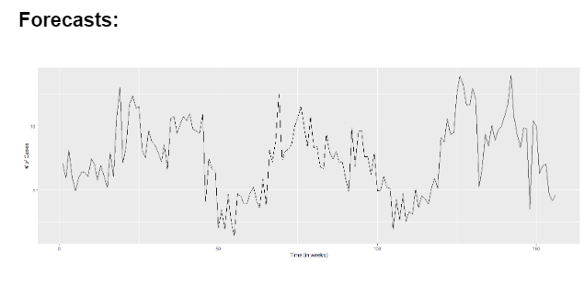
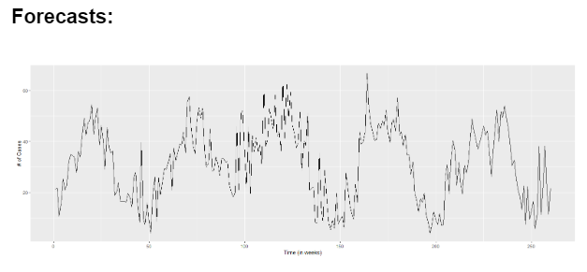
Linear Regression Models

Slide 10
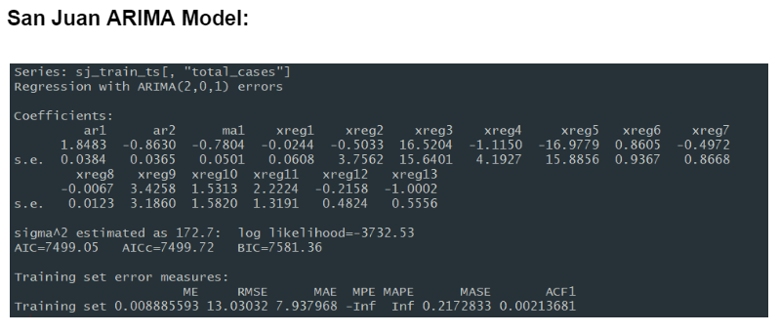
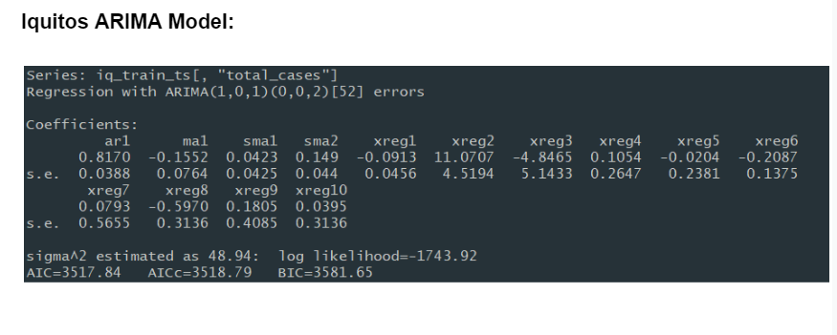
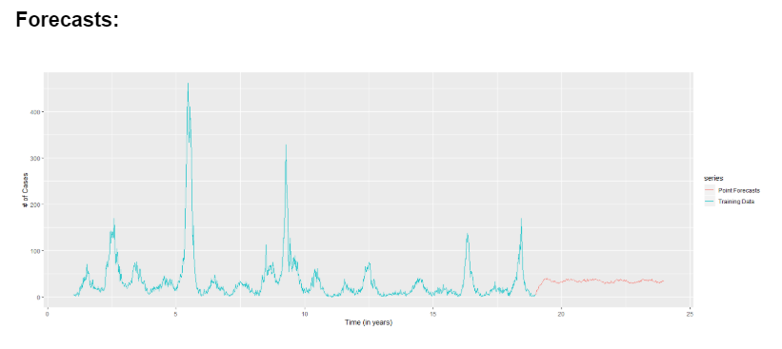
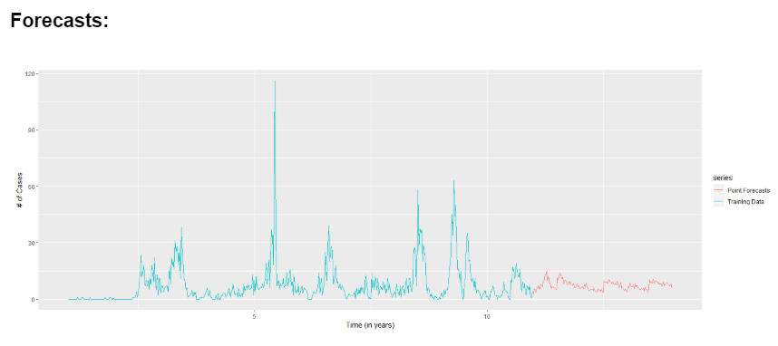
ARIMA Models

Slide 11
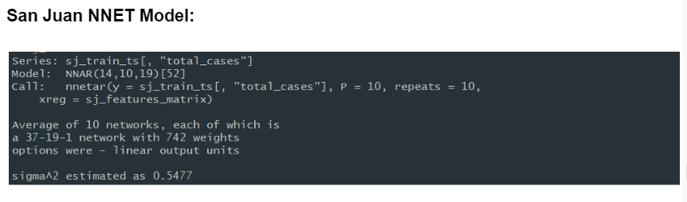
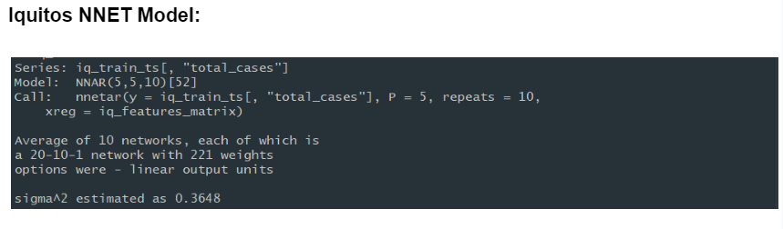
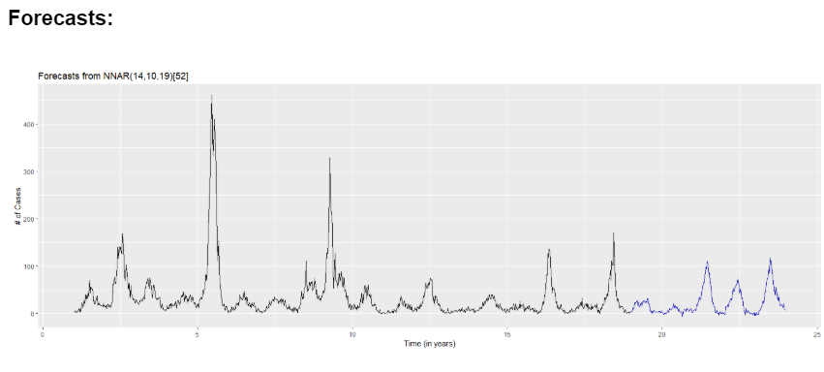
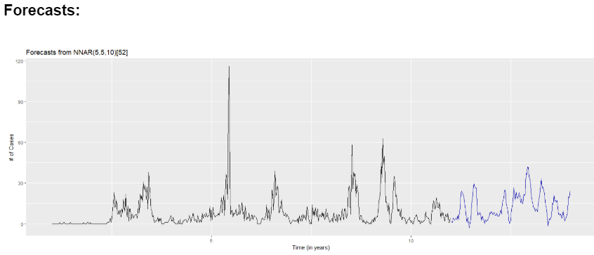
NNET Models

Slide 12
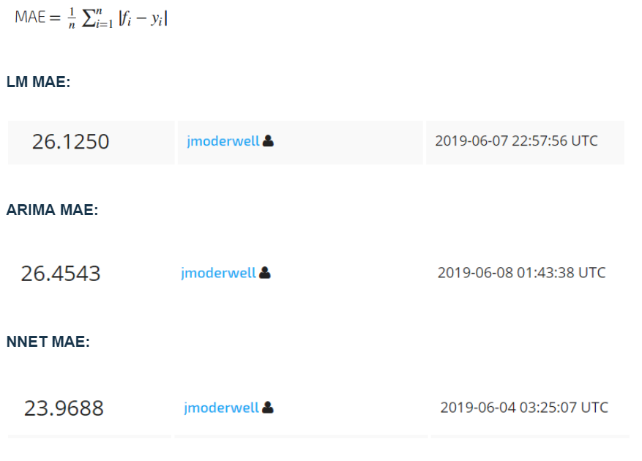
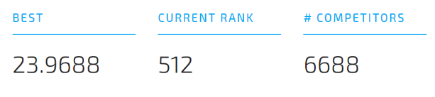
Performance / Accuracy
Performance/Accuracy:
The metric used for this competition is mean absolute error. The absolute error is calculated for each label in the submission and then averaged across the labels.

Slide 13
Summary/Conclusions
Neural net models had the highest predictive accuracy but the ARIMA and LM models were very close
Data preparation (including treatment of missing values) is very important because it can have a significant effect on model performance later on
Without prior knowledge of the data, interpretation of the models was difficult.
Since the models are limited to only precipitation/climate variables, the effects of other important factors are not captured or understood

Slide 14
Future Work
Compare time series methods to more complex machine learning methods
Explore other possibilities in feature creation
Take a look at Facebook Prophet model. I heard it is a powerful method for time series forecasting and could be good for this data

